Slide 1
Stoichiometry
Chapter 11
http://www.unit5.org/chemistry/Stoichiometry.html
Notes:
The Mole - Study Questions
1. What were Avogadro’s 2 major contributions to chemistry?
2. What is the unit for mass used on the periodic table?
3. How does molecular mass differ from molar mass?
4. Convert 200 g of FeO to moles.
5. Convert 3 mol of CO₂ to grams.
6. What is a conversion factor?
7. If 25 g of a substance equals 1 mole, what conversion factor would you use to convert 1.5 mol to grams?
8. What conversion factor would be used to convert 3 mol of the substance in question 10 to grams?
9. What is the unit used for molecular and formula mass?
10. What is the unit of molar mass?
11. The oxidation of 50.0 g of Mn produces 79.1 g of an oxide. Calculate (a) the percent composition, and (b) the empirical formula of this oxide.
12. What two things are conserved in a chemical reaction?
13. Why aren’t moles conserved in a chemical reaction?
For the next 4 questions balance the equation and calculate the indicated quantity.
14. K(s) + H₂O (g) → KOH(aq) + H₂(g) How much KOH will be produced from 100 g of K?
15. Fe₂O₃(s) + C → Fe(l) + CO(g) How much CO will be produced from 100 g of C?
16. CaC₂(s) + H₂O(l) → Ca(OH)₂(s) + CsH₂(g) How much CaC₂ is required to produce 100 g of C₂H₂?
17. C₄H₁₀(g) + O₂ → CO₂(g) + H₂O(l) How much H₂O can be produced using 100 g O₂?
18. What is a mole?
19. How many particles are there in a mole?

Slide 2






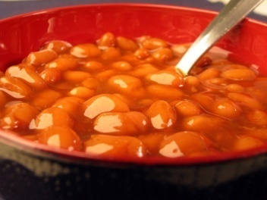
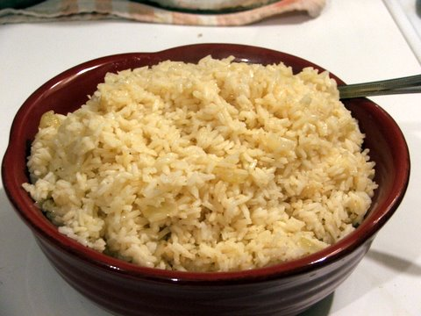
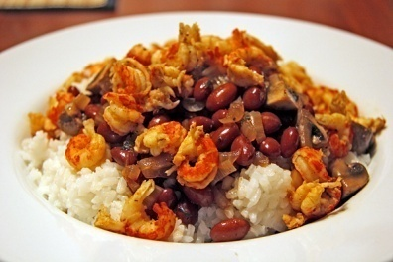
Guiding Questions
How are dosages determined?
How are toxins measured and controlled?
Which is better: eating beans and rice at separate meals
or together?
Notes:
What you should learn:
The dimension analysis method for handling quantities involved in a chemical reaction is based on proportions of the substances involved and is an important tool that allows for the measurement of all quantities in a chemical reactions - mass, volume, concentration, energy, etc.
Stoichiometric calculations allow one to make important measurements to ensure the health of people and animals.
More Specifically...:
State that chemicals react according to stoichiometric ratios (mole ratios)
Calculate concentrations using molarity
Solve Stoichiometry problems to convert the following
mole-mole;
mass-mass;
mole-mass;
mass-volume;
mole-volume; and
volume-volume.
Molarity-molarity
Molecule-molecule
Atom/ion-atom/ion
etc…
Identify the limiting reactant (reagent) in a reaction.
Determine the limiting reactant and calculate theoretical yield and excess reactant.
Solve percent yield problems
http://www.ispcorp.com/products/pharma/content/images/capsules2.jpg
http://images.google.com/imgres?imgurl=http://www.ehs.ufl.edu/Bio/abt_files/image010.jpg&imgrefurl=http://www.ehs.ufl.edu/Bio/toxin.htm&h=340&w=256&sz=12&hl=en&start=5&um=1&tbnid=4iSJ2CKfansiGM:&tbnh=119&tbnw=90&prev=/images%3Fq%3Dtoxins%26um%3D1%26hl%3Den
http://brinestorming.files.wordpress.com/2006/06/baked-beans.jpg

Slide 3
Stoichiometry
You should understand
  Moles, mass, representative particles (atoms, molecules, formula units), molar mass, and Avogadro’s number.
  The percent composition of an element in a compound.
  Balanced chemical equations: for example, for a given mass of a reactant, calculate the amount of produced.
  Limiting reactants: calculate the amount of product formed when given the amounts of all the reactants present.
  The percent yield of a reaction.
Notes:
Fast Track to a 5 (page 71)

Slide 4
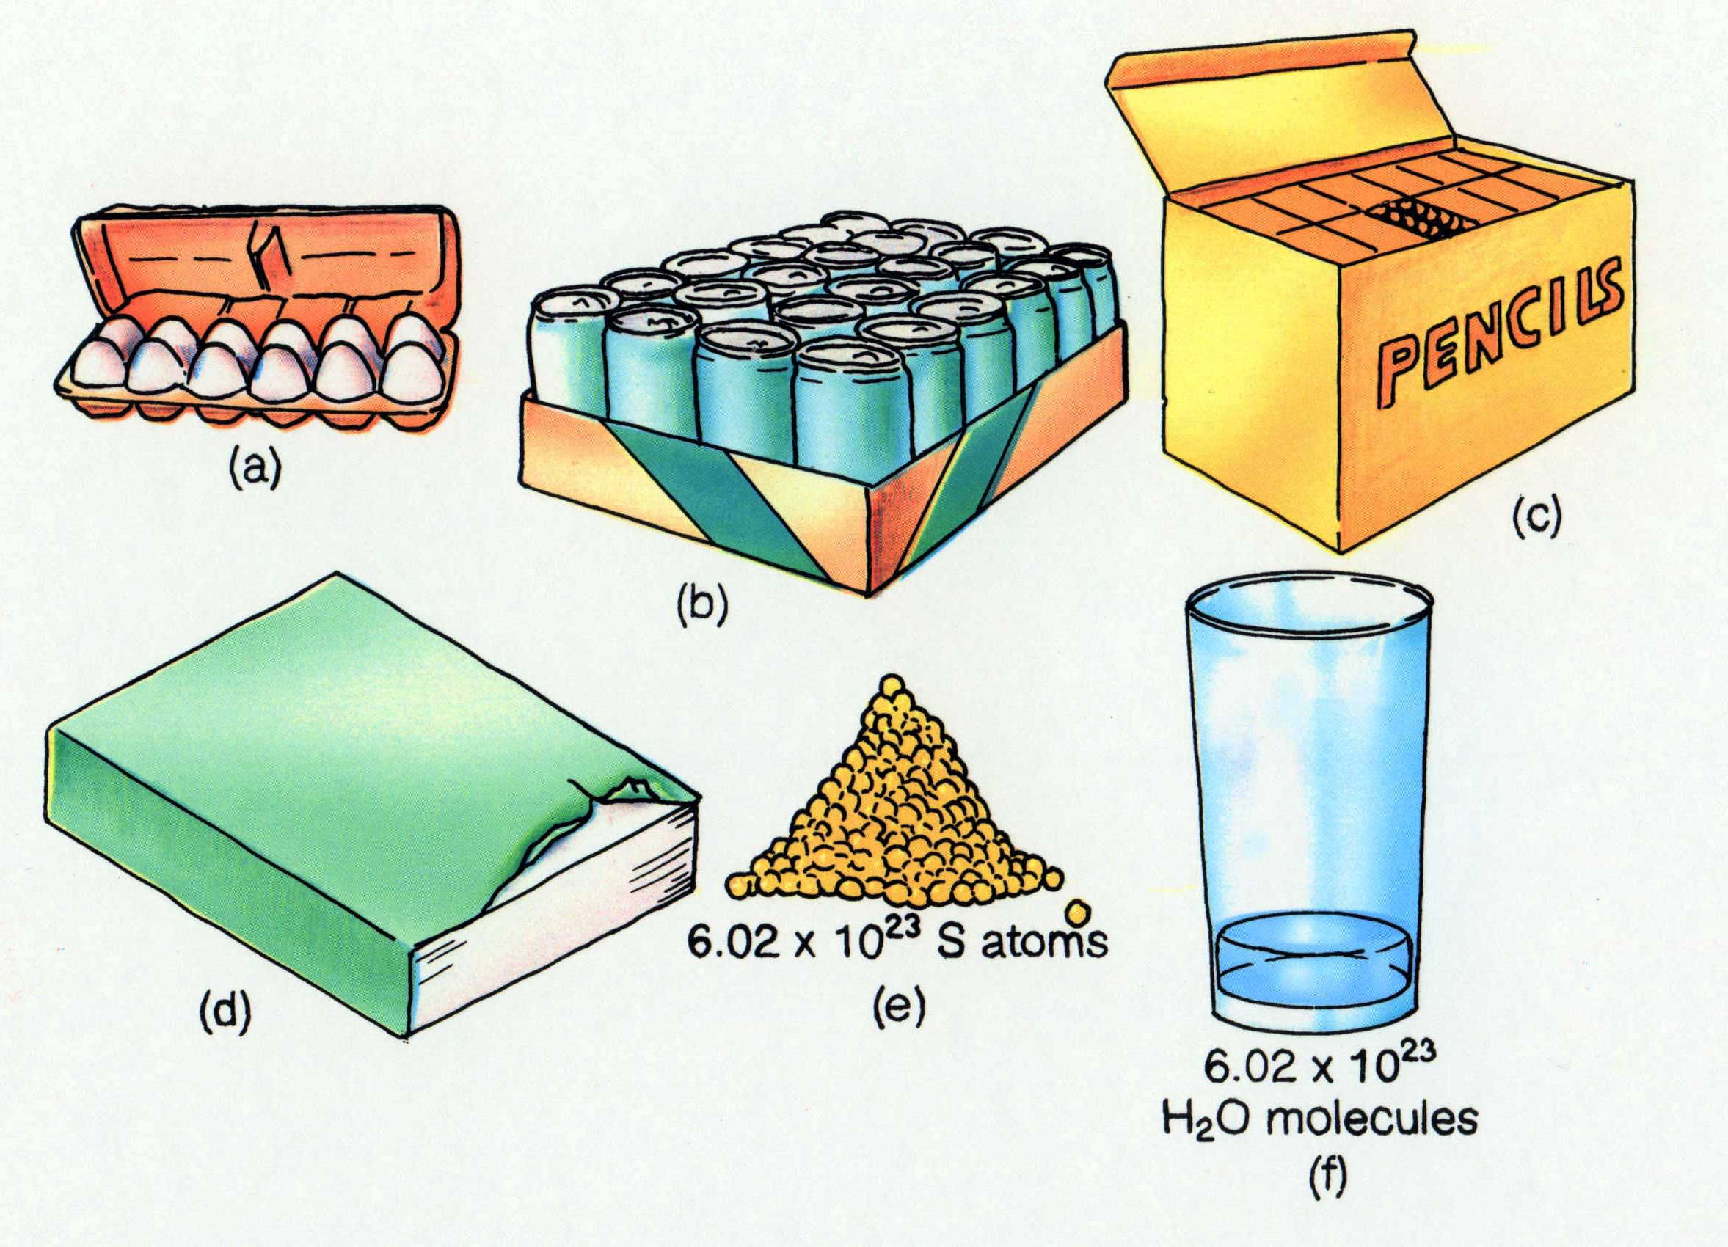
Some common collections and the numbers of items in them.
Timberlake, Chemistry 7th Edition, page 179

Slide 5

Balancing Chemical Equations
Coefficients
Notes:
http://www.woodenstilts.co.uk/images/animations/tightrope_walker_pole_a_hc.gif

Slide 6
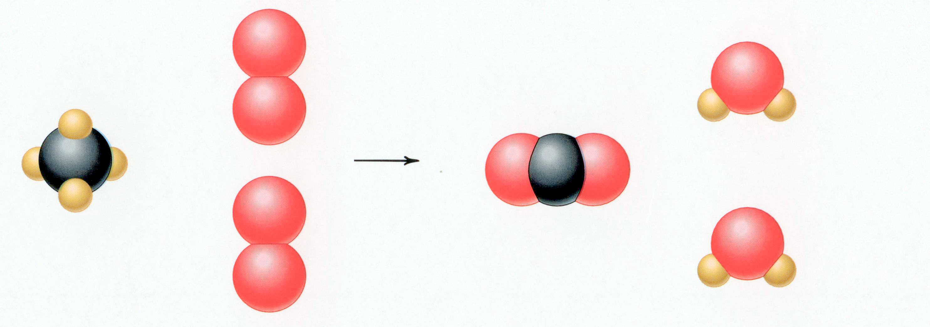
CH₄ + 2 O₂ → CO₂ + 2 H₂O
Reactants Products
1 C atom 1 C atom
4 H atoms 4 H atoms
4 O atoms 4 O atoms
Timberlake, Chemistry 7th Edition, page 167

Slide 7
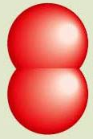
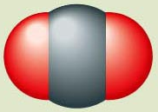
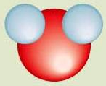

Reactants → Products
+
C(s) + O₂(g) CO₂(g)
carbon oxygen carbon dioxide
Reactants Product
1 carbon atom 1 carbon atom
2 oxygen atoms 2 oxygen atoms
catalyst – speeds up reaction
+
Pt
2
H₂(g) + O₂(g) H₂O (l)
hydrogen oxygen water
2
Pt
Reactants Product
2 hydrogen atoms 2 hydrogen atoms
2 oxygen atoms 1 oxygen atoms
Reactants Product
2 hydrogen atoms 4 hydrogen atoms
2 oxygen atoms 2 oxygen atoms
Reactants Product
4 hydrogen atoms 4 hydrogen atoms
2 oxygen atoms 2 oxygen atoms
Un
balanced
Timberlake, Chemistry 7th Edition, page 164

Slide 8
Unbalanced and Balanced Equations
H
Cl
Cl
Cl
H
H
H
Cl
Cl
Cl
Cl
H
H
H
H₂ + Cl₂ → HCl
(unbalanced)
H₂ + Cl₂ → 2 HCl
(balanced)
reactants products
reactants products
H
2
1
H
2
2
Cl
2
1
Cl
2
2

Slide 9
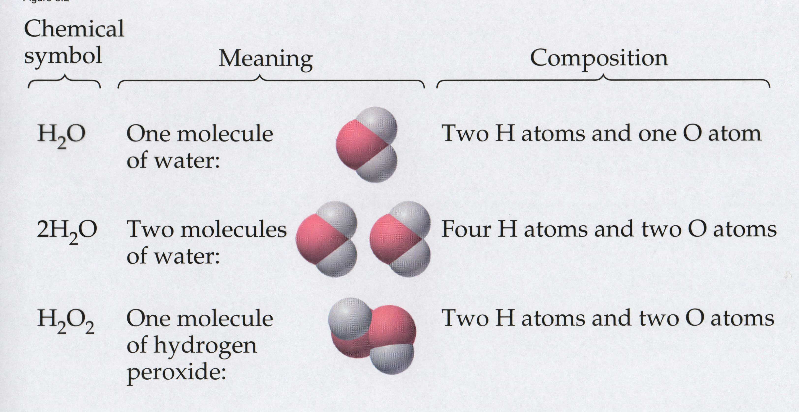
Meaning of Chemical Formula
Chemical
Symbol Meaning Composition
H₂O One molecule
of water:
Two H atoms and one O atom
2 H₂O Two molecules
of water:
Four H atoms and two O atoms
H₂O₂ One molecule
of hydrogen
peroxide:
Two H atoms and two O atoms

Slide 10


Welcome to Mole Island
1 mol = molar mass
1 mole = 22.4 L
@ STP
1 mol =
6.02 x 10²³ particles

Slide 11

Stoichiometry Island Diagram
Known Unknown
Substance A Substance B
M
Mass
Mass Mountain
Mass
Mole Island
V
Volume
Mole
Mole
Volume
Liter Lagoon
Particles
Particles
P
Particle Place
Stoichiometry Island Diagram

Slide 12
Stoichiometry Island Diagram
Known Unknown
Substance A Substance B
Mass
Mass
1 mole = molar mass (g)
1 mole = molar mass (g)
Use coefficients
from balanced
chemical equation
Volume
1 mole = 22.4 L @ STP
Mole
Mole
Volume
1 mole = 22.4 L @ STP
(gases)
(gases)
1 mole = 6.022 x 10²³ particles
(atoms or molecules)
Particles
1 mole = 6.022 x 10²³ particles
(atoms or molecules)
Particles
Stoichiometry Island Diagram

Slide 13
Stoichiometry Island Diagram
Known Unknown
Substance A Substance B
M
Mass
Mass Mountain
Mass
V
Volume
Mole
Mole
Volume
Liter Lagoon
Particles
Particles
P
Particle Place
Stoichiometry Island Diagram

Slide 14
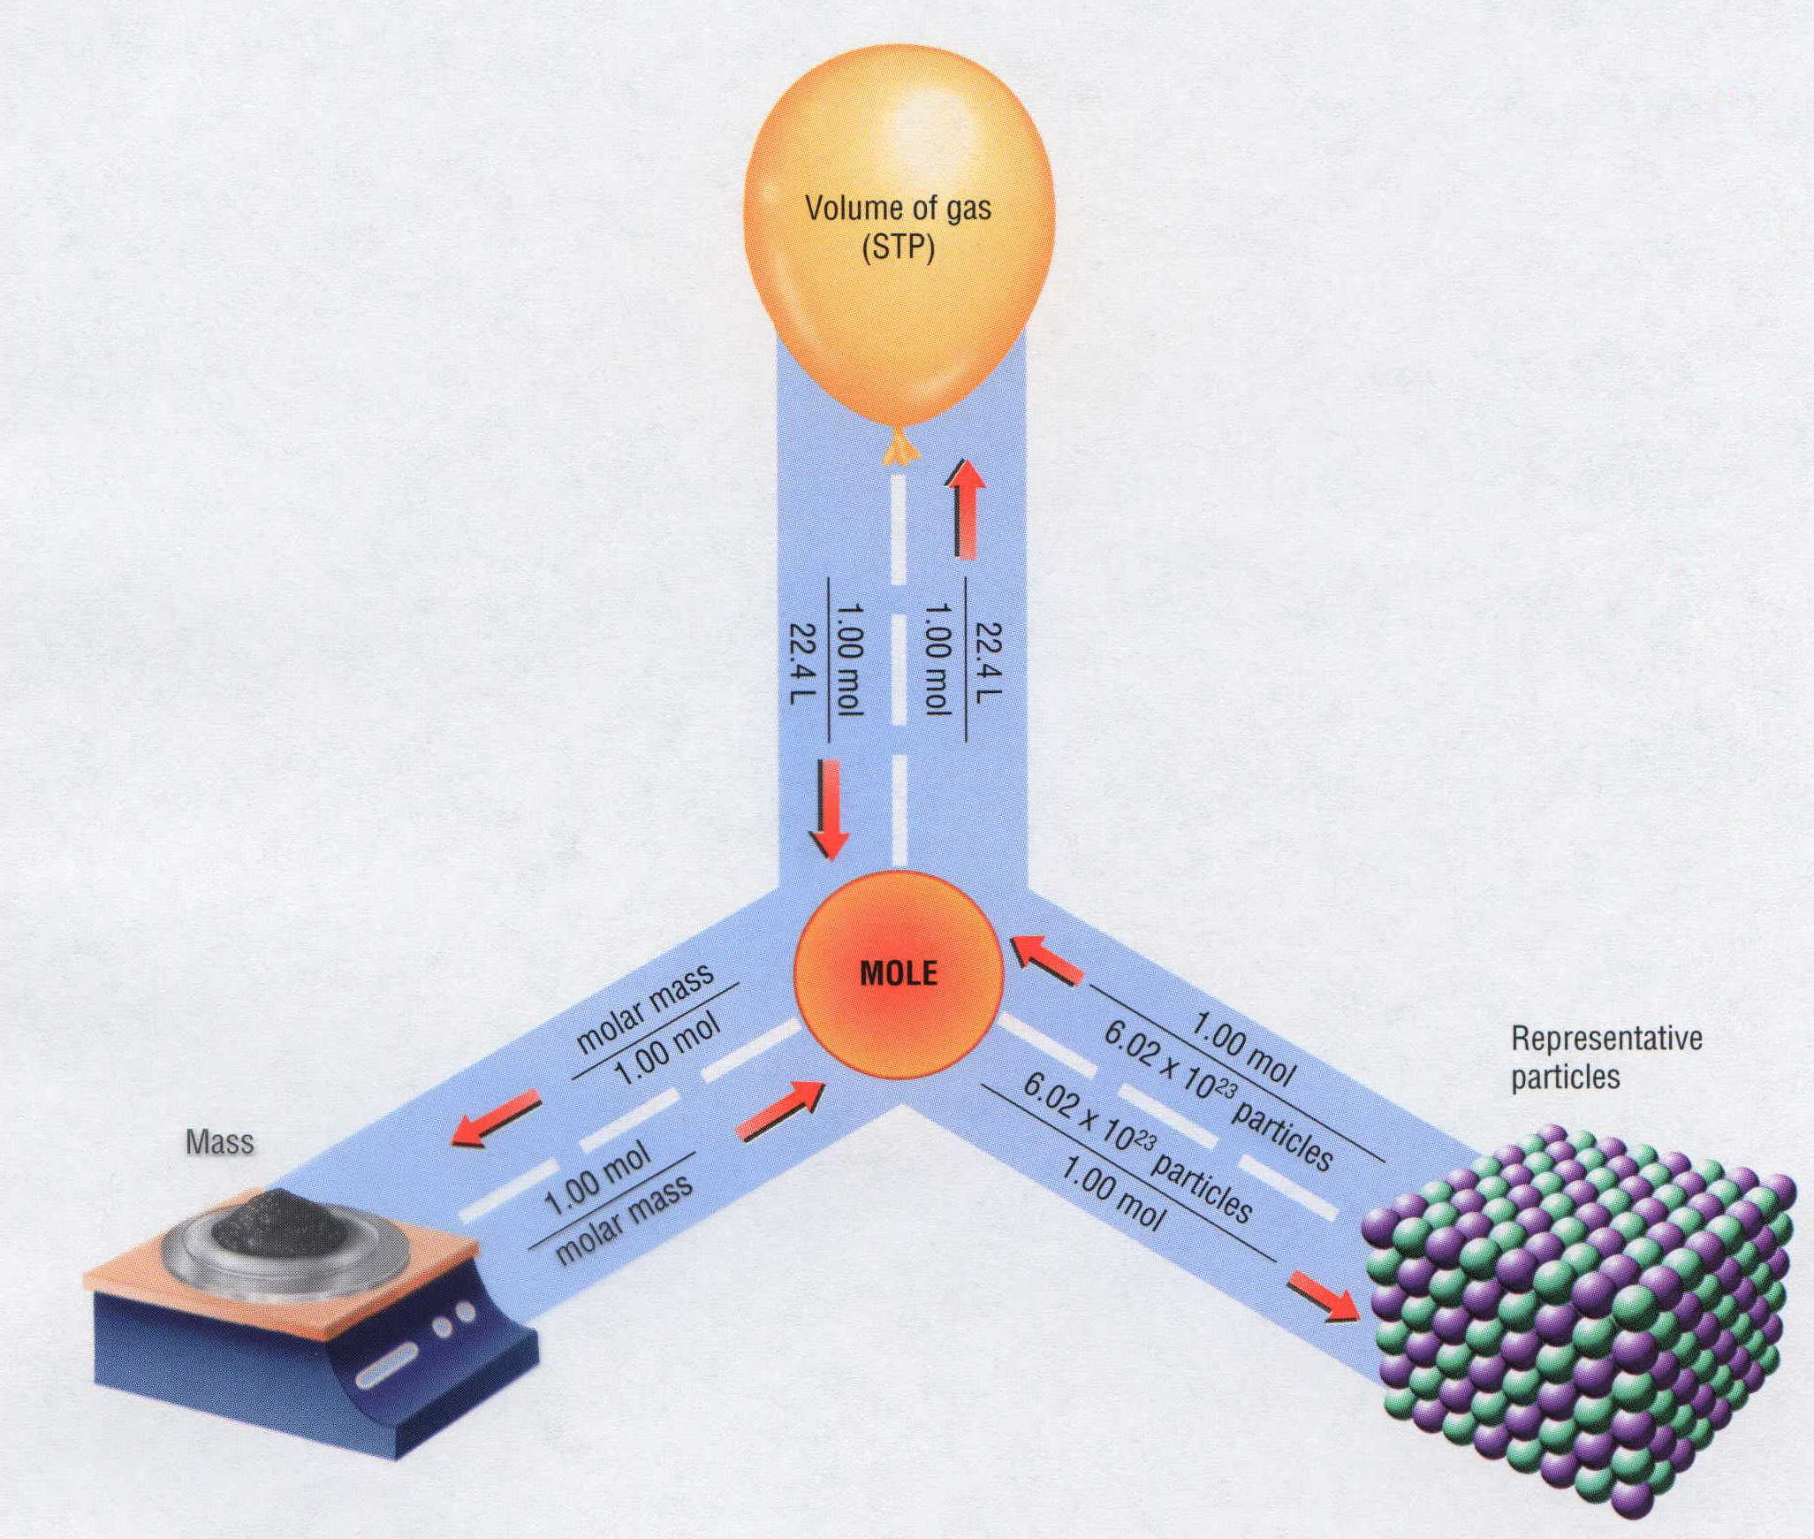
Mass, Volume, Mole Relationship

Slide 15
Mole Calculations
Notes:
Objectives:
To relate the moles of a substance to the number of particles.
To relate the mass of a substance to the number of particles.
To state the value for the molar volume of any gas at STP: 22.4 L/mol.
To relate the density of a gas at STP to its molar mass and volume.
To relate the volume of a gas at STP to its mass and number of particles.

Slide 16
Visualizing a Chemical Reaction
2
2
Na + Cl₂ NaCl
10
5
10
10
10
5
?
___ mole Na
___ mole Cl₂
___ mole NaCl

Slide 17
Visualizing a Chemical Reaction
2
2
Na + Cl₂ NaCl
10
5
10
___ mole Na
___ mole Cl₂
___ mole NaCl

Slide 18
Proportional Relationships
2 1/4 c. flour
1 tsp. baking soda
1 tsp. salt
1 c. butter
3/4 c. sugar
3/4 c. brown sugar
1 tsp vanilla extract
2 eggs
2 c. chocolate chips
Makes 5 dozen cookies.
I have 5 eggs. How many cookies can I make?
Ratio of eggs to cookies
5 eggs
5 doz.
2 eggs
150 cookies
= 12.5 dozen cookies
Courtesy Christy Johannesson www.nisd.net/communicationsarts/pages/chem

Slide 19
Proportional Relationships
Stoichiometry
  mass relationships between substances in a chemical reaction
  based on the mole ratio
Mole Ratio
  indicated by coefficients in a balanced equation
2 Mg + O₂ → 2 MgO
Courtesy Christy Johannesson www.nisd.net/communicationsarts/pages/chem
Notes:
A balanced chemical equation gives the identity of the reactants and products and the accurate number of molecules or moles of each that are consumed or produced.
Stoichiometry is a collective term for the quantitative relationships between the masses, numbers of moles, and numbers of particles (atoms, molecules, and ions) of the reactants and products in a balanced reaction.
A stoichiometric quantity is the amount of product or reactant specified by the coefficients in a balanced chemical equation.

Slide 20
Stoichiometry Steps
1. Write a balanced equation.
2. Identify known & unknown.
3. Line up conversion factors.
  Mole ratio - moles ↔ moles
  Molar mass - moles ↔ grams
  Molarity - moles ↔ liters soln
  Molar volume - moles ↔ liters gas
  Mole ratio - moles ↔ moles
Core step in all stoichiometry problems!!
4. Check answer.
Courtesy Christy Johannesson www.nisd.net/communicationsarts/pages/chem

Slide 21
Molar Volume at STP
1 mol of a gas=22.4 L
at STP
Standard Temperature & Pressure
0°C and 1 atm
Courtesy Christy Johannesson www.nisd.net/communicationsarts/pages/chem

Slide 22
Molar Volume at STP
LITERS
OF GAS
AT STP
Molar Volume
(22.4 L/mol)
MASS
IN
GRAMS
MOLES
NUMBER
OF
PARTICLES
Molar Mass
(g/mol)
6.02 × 10²³
particles/mol
Molarity (mol/L)
LITERS
OF
SOLUTION
Courtesy Christy Johannesson www.nisd.net/communicationsarts/pages/chem

Slide 23
Stoichiometry Problems
How many moles of KClO₃ must decompose in order to produce 9 moles of oxygen gas?
2KClO₃ → 2KCl + 3O₂
? mol
9 mol
9 mol O₂
2 mol KClO₃
3 mol O₂
= 6 mol KClO₃
Courtesy Christy Johannesson www.nisd.net/communicationsarts/pages/chem

Slide 24
How many moles of KClO₃ must decompose in order to produce 9 moles of oxygen gas?
2KClO₃ → 2KCl + 3O₂
? mol
9 mol
9 mol O₂
2 mol KClO₃
3 mol O₂
= 6 mol KClO₃
x mol KClO₃ = 9 mol O₂
2 mol KClO₃
6 mol
3 mol O₂
= 6 mol KClO₃
O₂
KClO₃
Courtesy Christy Johannesson www.nisd.net/communicationsarts/pages/chem

Slide 25
Stoichiometry Problems
How many grams of KClO₃ are required to produce 9.00 L of O₂ at STP?
2KClO₃ → 2KCl + 3O₂
? g
9.00 L
9.00 L
O₂
1 mol
O₂
22.4 L
O₂
2 mol
KClO₃
3 mol
O₂
122.55
g KClO₃
1 mol
KClO₃
= 32.8 g
KClO₃
Courtesy Christy Johannesson www.nisd.net/communicationsarts/pages/chem

Slide 26
Stoichiometry Problems
How many grams of KClO₃ are required to produce 9.00 L of O₂ at STP?
2KClO₃ → 2KCl + 3O₂
? g
9.00 L
1 mol O₂
2 mol KClO₃
122.55 g KClO₃
32.8 g
x g KClO₃ = 9.00 L O₂
3 mol O₂
1 mol KClO₃
= 32.8 g KClO₃
22.4 L O₂
O₂
KClO₃
Courtesy Christy Johannesson www.nisd.net/communicationsarts/pages/chem

Slide 27
How many grams of KClO₃ are required to produce 9.00 L of O₂ at STP?
2KClO₃ → 2KCl + 3O₂
? g
9.00 L
9.00 L
O₂
1 mol
O₂
22.4 L
O₂
2 mol
KClO₃
3 mol
O₂
122.55
g KClO₃
1 mol
KClO₃
= 32.8 g
KClO₃
1 mol O₂
2 mol KClO₃
122.55 g KClO₃
32.8 g
x g KClO₃ = 9.00 L O₂
3 mol O₂
1 mol KClO₃
= 32.8 g KClO₃
22.4 L O₂
O₂
KClO₃
Courtesy Christy Johannesson www.nisd.net/communicationsarts/pages/chem

Slide 28
How many grams of silver will be formed from 12.0 g copper?
Cu + 2 AgNO₃ → 2 Ag + Cu(NO₃)₂
12.0 g
? g
12.0
g Cu
1 mol
Cu
63.55
g Cu
2 mol
Ag
1 mol
Cu
107.87
g Ag
1 mol
Ag
= 40.7 g
Ag
1 mol Cu
2 mol Ag
107.87 g Ag
40.7 g
x g Ag = 12.0 g Cu
1 mol Cu
1 mol Ag
= 40.7 g Ag
63.55 g Cu
Cu
Ag
Courtesy Christy Johannesson www.nisd.net/communicationsarts/pages/chem

Slide 29
Limiting Reactants
Caution: this stuff is difficult to follow at first.
Be patient.

Slide 30
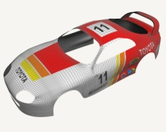



Limiting Reactants
+
plus 16 tires
excess
8 car bodies
48 tires
8 cars
CB + 4 T CT₄
Notes:
http://www.brettschmidt.com/3d_images/garage/samples/car_body.jpg

Slide 31
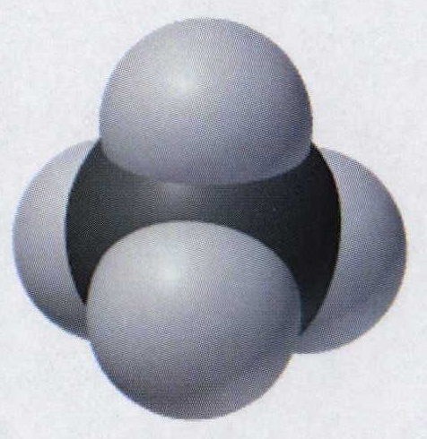
Limiting Reactants
Methane, CH₄
+
plus 8
hydrogen
molecules
excess
plus 16
hydrogen
atoms
excess
8 carbon
atoms
24 hydrogen
molecules
8 methane
molecules
C + 2 H₂ CH₄
Notes:
http://www.brettschmidt.com/3d_images/garage/samples/car_body.jpg

Slide 32
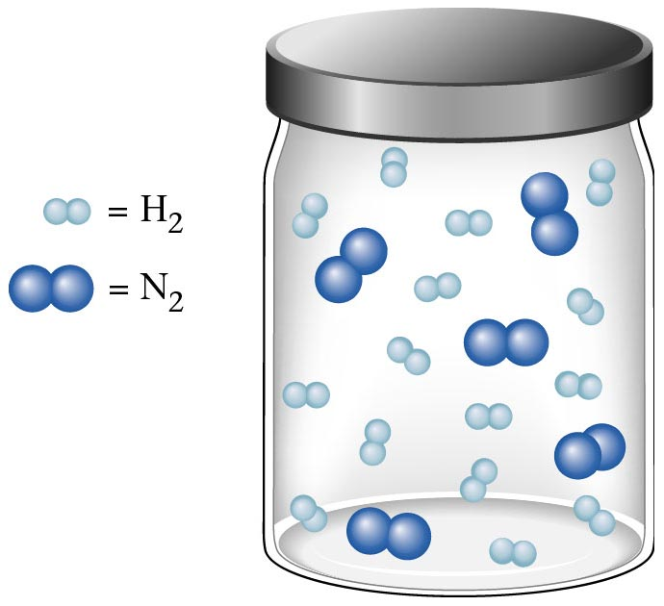
Container 1
Zumdahl, Zumdahl, DeCoste, World of Chemistry 2002, page 269

Slide 33
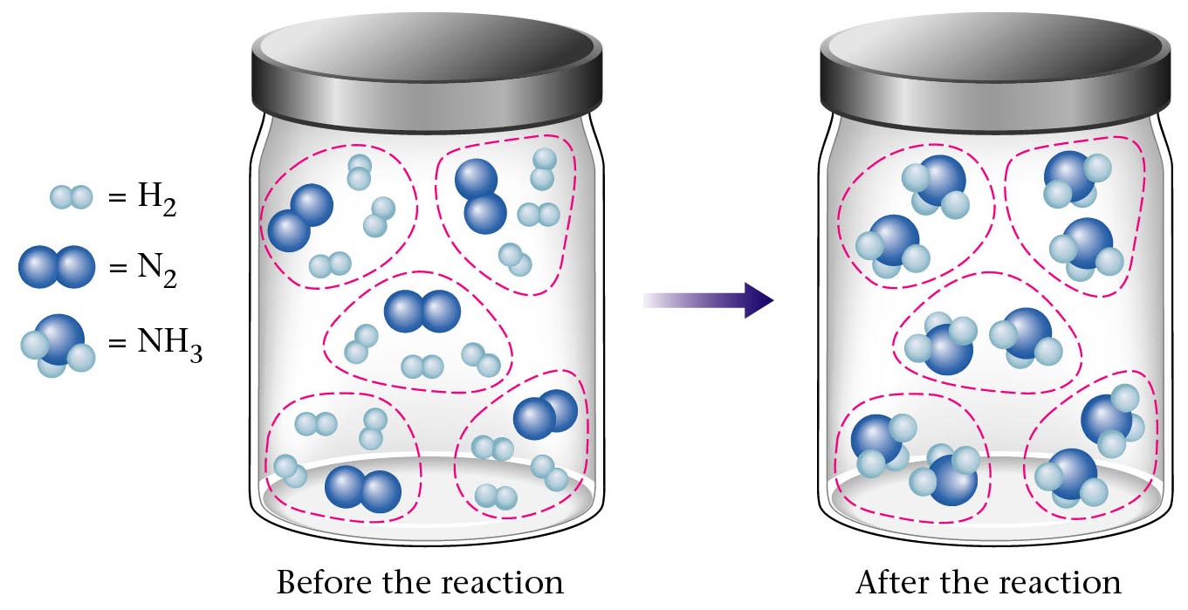
Before and After Reaction 1
2
N₂ + H₂ NH₃
3
Before the reaction
After the reaction
All the hydrogen and nitrogen atoms combine.
Zumdahl, Zumdahl, DeCoste, World of Chemistry 2002, page 269

Slide 34
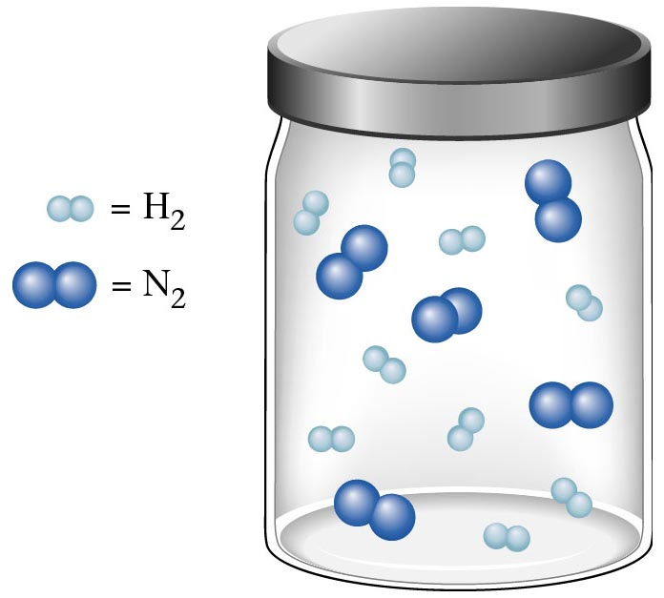
Container 2
Zumdahl, Zumdahl, DeCoste, World of Chemistry 2002, page 270

Slide 35
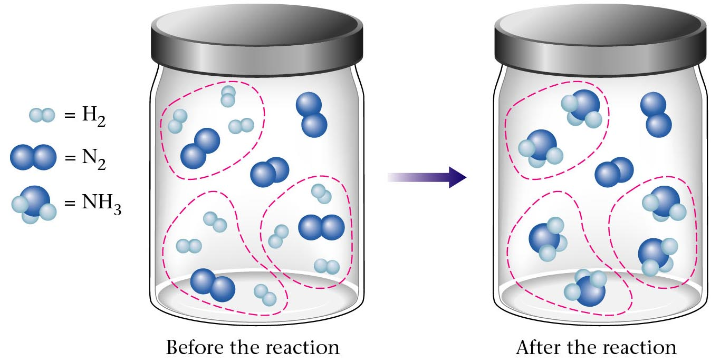
Before and After Reaction 2
2
N₂ + H₂ NH₃
3
excess
limiting
Before the reaction
After the reaction
LIMITING REACTANT DETERMINES AMOUNT OF PRODUCT
Zumdahl, Zumdahl, DeCoste, World of Chemistry 2002, page 270

Slide 36
Real-World Stoichiometry:
Limiting Reactants
Fe + S FeS
Ideal
Stoichiometry
Limiting
Reactants
S =
Fe =
excess
LeMay Jr, Beall, Robblee, Brower, Chemistry Connections to Our Changing World , 1996, page 366

Slide 37

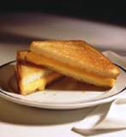
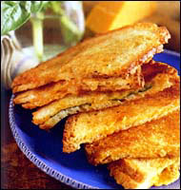
Grilled Cheese Sandwich
Bread + Cheese → ‘Cheese Melt’
2 B + C → B₂C
100 bread
30 slices
30 sandwiches
? sandwiches
Multiple Guess:
130 sandwiches
100 sandwiches
90 sandwiches
60 sandwiches
30 sandwiches
Not enough information given

Slide 38
Limiting Reactants
Available Ingredients
  4 slices of bread
  1 jar of peanut butter
  1/2 jar of jelly
Limiting Reactant
  bread
Excess Reactants
  peanut butter and jelly
Courtesy Christy Johannesson www.nisd.net/communicationsarts/pages/chem

Slide 39
Limiting Reactants
Limiting Reactant
  used up in a reaction
  determines the amount of product
Excess Reactant
  added to ensure that the other reactant is completely used up
  cheaper & easier to recycle
Courtesy Christy Johannesson www.nisd.net/communicationsarts/pages/chem
Notes:
If one or more of the reactants is not used up completely but is left over when the reaction is completed, then the amount of product that can be obtained is limited by the amount of only one of the reactants
A limiting reactant is the reactant that restricts the amount of product obtained. The reactant that remains after a reaction has gone to completion is present in excess.

Slide 40
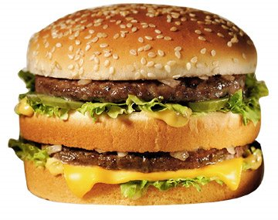
The Limiting Reactant
A balanced equation for making a Big Mac® might be:
3 B + 2 M + EE B₃M₂EE
With… | …and… | …one can make…
excess B and
excess EE
30 M
15 B₃M₂EE
excess M and
excess EE
30 B
10 B₃M₂EE
30 B and
excess EE
30 M
10 B₃M₂EE

Slide 41
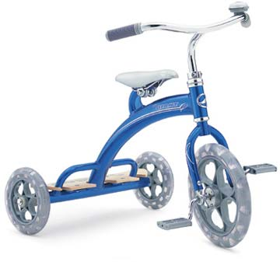
The Limiting Reactant
A balanced equation for making a tricycle might be:
3 W + 2 P + S + H + F W₃P₂SHF
With… | …and… | …one can make…
50 P
excess of all
other reactants
25 W₃P₂SHF
50 S
excess of all
other reactants
50 W₃P₂SHF
50 S and
excess of all
other reactants
50 P
25 W₃P₂SHF

Slide 42

Limiting Reactants
aluminum + chlorine gas → aluminum chloride
Al(s) + Cl₂(g) → AlCl₃
2 Al(s) + 3 Cl₂(g) → 2 AlCl₃
100 g 100 g ? g
A. 200 g B. 125 g C. 667 g D. 494 g

Slide 43
Limiting Reactants
aluminum + chlorine gas → aluminum chloride
2 Al(s) + 3 Cl₂(g) → 2 AlCl₃
100 g 100 g x g
How much product would be made if we begin with 100 g of aluminum?
x g AlCl₃ = 100 g Al
1 mol Al
2 mol AlCl₃
133.5 g AlCl₃
27 g Al
2 mol Al
1 mol AlCl₃
= 494 g AlCl₃
Al
AlCl₃
How much product would be made if we begin with 100 g of chlorine gas?
x g AlCl₃ = 100 g Cl₂
1 mol Cl₂
2 mol AlCl₃
133.5 g AlCl₃
71 g Cl₂
3 mol Cl₂
1 mol AlCl₃
= 125 g AlCl₃
Cl₂
AlCl₃

Slide 44
Limiting Reactants – Method 1
1. Write a balanced equation.
2. For each reactant, calculate the amount of product formed.
3. Smaller answer indicates:
  limiting reactant
  amount of product
Courtesy Christy Johannesson www.nisd.net/communicationsarts/pages/chem

Slide 45
Limiting Reactants – Method 2
Begin by writing a correctly balanced chemical equation
Write down all quantitative values under equation (include units)
Convert ALL reactants to units of moles
Divide by the coefficient in front of each reactant
The smallest value is the limiting reactant!

Slide 46
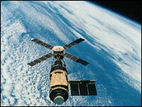
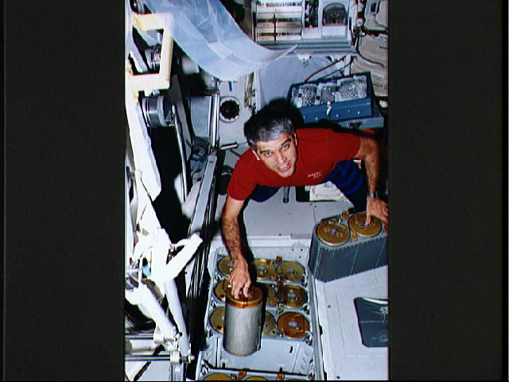

Stoichiometry in the Real World

Slide 47
Air Bag Design
Exact quantity of nitrogen gas must be produced in an instant.
Use a catalyst to speed up the reaction
2 NaN₃(s) → 2 Na(s) + 3 N₂(g)
6 Na(s) + Fe₂O₃(s) → 3 Na₂O(s) + 2 Fe (s)

Slide 48
Airbag Design
2 NaN₃(s) → 2 Na(s) + 3 N₂(g)
6 Na(s) + Fe₂O₃(s) → 3 Na₂O(s) + 2 Fe(s)
Assume that 65.1 L of N₂ gas are needed to inflate an air bag to the
proper size. How many grams of NaN₃ must be included in the gas
generant to generate this amount of N₂?
(Hint: The density of N₂ gas at this temperature is about 0.916 g/L).
65.1 L N₂
x 0.916 g/L N₂
1 mol N₂
2 mol NaN₃
65 g NaN₃
x g NaN₃ = 59.6 g N₂
28 g N₂
3 mol N₂
1 mol NaN₃
59.6 g N₂
X = 92.2 g NaN₃
How much Fe₂O₃ must be added to the gas generant for this amount of NaN₃?
1 mol NaN₃
2 mol Na
1 mol Fe₂O₃
159.6 g Fe₂O₃
x g Fe₂O₃ = 92.2 g NaN₃
65 g NaN₃
2 mol NaN₃
6 mol Na
1 mol Fe₂O₃
X = 37.7 g Fe₂O₃

Slide 49
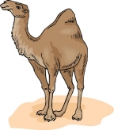
Water from a Camel
Camels store the fat tristearin (C₅₇H₁₁₀O₆) in the hump. As well as
being a source of energy, the fat is a source of water, because when
it is used the reaction
takes place.
2 C₅₇H₁₁₀O₆(s) + 163 O₂(g) → 114 CO₂(g) + 110 H₂O(l)
What mass of water can be made from 1.0 kg of fat?
1000 g “fat”
1 mol “fat”
110 mol H₂O
18 g H₂O
x g H₂O = 1 kg ‘fat”
1 kg “fat”
890 g “fat”
2 mol “fat”
1 mol H₂O
X = 1112 g H₂O
or 1.112 liters water

Slide 50
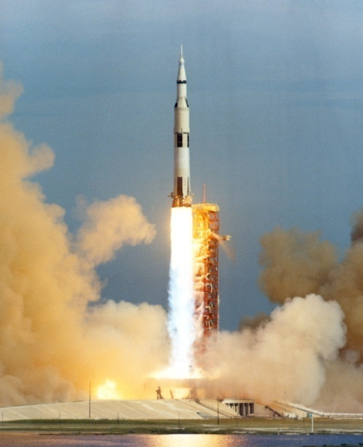
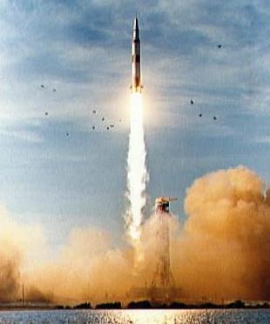
Rocket Fuel
The compound diborane (B₂H₆) was at one time
considered for use as a rocket fuel. How many grams
of liquid oxygen would a rocket have to carry to burn
10 kg of diborane completely?
(The products are B₂O₃ and H₂O).
Chemical equation
B₂H₆ + O₂
B₂O₃ + H₂O
Balanced chemical equation
B₂H₆ + O₂ B₂O₃ + H₂O
3
3
10 kg x g
1000 g B₂H₆
1 mol B₂H₆
3 mol O₂
32 g O₂
x g O₂ = 10 kg B₂H₆
1 kg B₂H₆
28 g B₂H₆
1 mol B₂H₆
1 mol O₂
X = 34,286 g O₂

Slide 51

Water in Space
Click
Here
In the space shuttle, the CO₂ that the crew exhales is removed from the
air by a reaction within canisters of lithium hydroxide. On average, each
astronaut exhales about 20.0 mol of CO₂ daily. What volume of water will
be produced when this amount of CO₂ reacts with an excess of LiOH?
(Hint: The density of water is about 1.00 g/mL.)
CO₂(g) + 2 LiOH(s) → Li₂CO₃(aq) + H₂O(l)
20.0 mol
excess
x g
Water is NOT at STP!
1 mol H₂O
18 g H₂O
22.4 L H₂O
1 mL H₂O
x mL H₂O = 20.0 mol CO₂
1 mol CO₂
1 mol H₂O
1 g H₂O
X = 360 mL H₂O

Slide 52
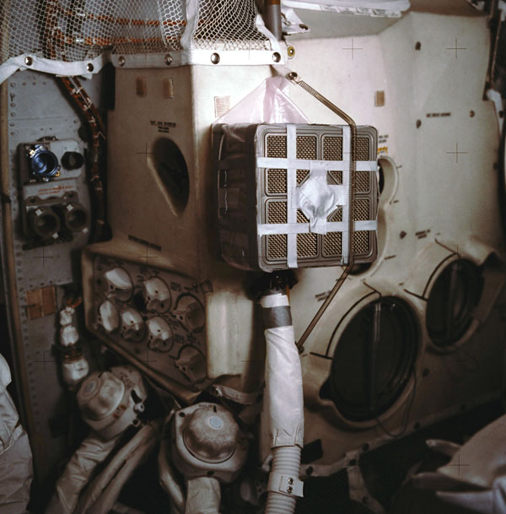
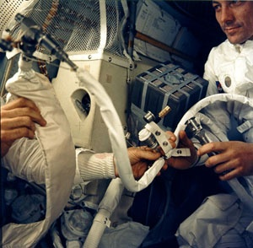
Lithium Hydroxide Scrubber
Modified by Apollo 13 Mission
Astronaut John L. Swigert holds the
jury-rigged lithium hydroxide scrubber
used to remove excess carbon dioxide
from the damaged Apollo 13 spacecraft.
Notes:
http://images.google.com/imgres?imgurl=http://www.space1.com/Artifacts/Apollo_Artifacts/LiOH_Canister/apollo_13_photo2_600.jpg&imgrefurl=http://www.space1.com/Artifacts/Apollo_Artifacts/LiOH_Canister/lioh_canister.html&h=609&w=600&sz=99&hl=en&start=7&tbnid=IN4zfhqzwnHKYM:&tbnh=136&tbnw=134&prev=/images%3Fq%3DApollo%2B%2B13%2Blithium%2Bhydroxide%2Bscrubber%26gbv%3D2%26svnum%3D10%26hl%3Den
http://www.spurgeonworld.com/blog/images/as13-62-9004.jpg
Interior view of the Apollo 13 Lunar Module (LM) as the astronauts jerry-rig a system to use the Command Module lithium hydroxide canisters to purge carbon dioxide from the LM. Photo: NASA/JSC

Slide 53
Water in Space
In the space shuttle, the CO₂ that the crew exhales is removed from the
air by a reaction within canisters of lithium hydroxide. On average, each
astronaut exhales about 20.0 mol of CO₂ daily. What volume of water will
be produced when this amount of CO₂ reacts with an excess of LiOH?
(Hint: The density of water is about 1.00 g/mL.)
CO₂(g) + 2 LiOH(s) → Li₂CO₃(aq) + H₂O(l)
20.0 mol
excess
x g
Water is NOT at STP!
1 mol H₂O
18 g H₂O
22.4 L H₂O
1 mL H₂O
x mL H₂O = 20.0 mol CO₂
1 mol CO₂
1 mol H₂O
1 g H₂O
X = 360 mL H₂O

Slide 54
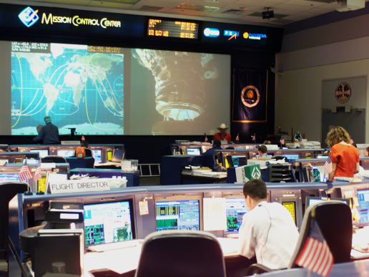
Real Life Problem Solving
Determine the amount of LiOH required for a seven-day mission in space
for three astronauts and one ‘happy’ chimpanzee. Assume each passenger
expels 20 mol of CO₂ per day.
Note: The lithium hydroxide scrubbers are only 85% efficient.
(4 passengers) x (10 days) x (20 mol/day) = 800 mol CO₂
Plan for a delay
CO₂(g) + 2 LiOH(s) → Li₂CO₃(aq) + H₂O(l)
800 mol X g
Notes:
http://www.nasa.gov/images/content/64569main_ffs_gallery_mcc_image3.jpg

Slide 55
CO₂(g) + 2 LiOH(s) → Li₂CO₃(aq) + H₂O(l)
800 mol
38,240 g
x g
x 23.9 g/mol
800 mol
1:2
1600 mol
Needed
(actual yield)
2 mol LiOH
23.9 g LiOH
X g LiOH = 800 mol CO₂
= 38,240 g LiOH
1 mol CO₂
1 mol LiOH
Note: The lithium hydroxide scrubbers are only 85% efficient.
Actual Yield
Theoretical Yield
38,240 g LiOH
% Yield =
0.85
=
x g LiOH
Amount of LiOH to
be taken into space
x = 44,988 g LiOH

Slide 56
Careers in Chemistry: Farming
Farming is big business in the United States with profits for the lucky and
possible bankruptcy for the less fortunate. Farmers should not be ignorant of
chemistry. For instance, to be profitable, a farmer must know when to plant,
harvest, and sell his/her crops to maximize profit. In order to get the greatest
yield farmers often add fertilizers to the soil to replenish vital nutrients removed
by the previous season’s crop.
Corn is one product that removes a tremendous amount of phosphorous
from the soil. For this reason, farmers will rotate crops and/or add fertilizer to
the ground before planting crops for the following year. On average, an acre
of corn will remove 6 kilograms of phosphorous from the ground.
Assume you inherit a farm and must now have to purchase fertilizer for the
farm. The farm is 340 acres and had corn planted the previous year. You must
add fertilizer to the soil before you plant this years’ crop. You go to the local
fertilizer store and find SuperPhosphateTM brand fertilizer. You read the fertilizer
bag and can recognize from your high school chemistry class a molecular formula Ca₃P₂H₁₄S₂O₂₁ (you don’t understand anything else written on the bag because it
is imported fertilizer from Japan). You must decide how much fertilizer to buy for application to your corn fields. If each bag costs $54.73; how many bags of
fertilizer must you purchase and how much will it cost you to add the necessary fertilizer to your fields?
Given: 1 bag of fertilizer weighs 10,000 g [454 g = 1 pound]

Slide 57
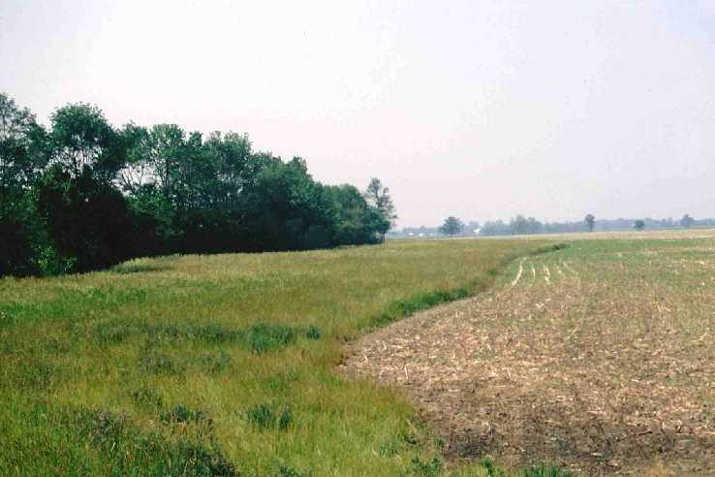
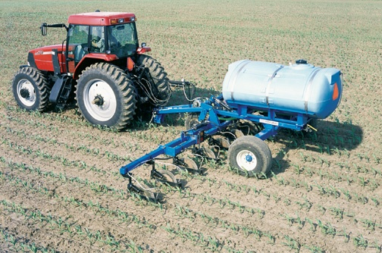
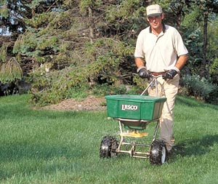
Careers in Chemistry: Farming
How much fertilizer will you need?
Conversion Factor: 1 acre corn = 6 kg phosphorous
If a bag of fertilizer has the formula Ca₃P₂H₁₄S₂O₂₁,
The molar mass of it is 596 g/mol.
3 Ca @ 40g/mol = 120 g
2 P@ 31 g/mol = 62 g
14 H@ 1 g/mol = 14 g
2 S@ 32 g/mol = 64 g
21 O @ 16 g/mol = 335 g
Ca₃P₂H₁₄S₂O₂₁
In a bag of fertilizer you have 10.4 % (by mass) phosphorous.
A bag of fertilizer weighs 10,000 g (about 22 pounds).
10.4 % of 10,000 g =
2.04 x 10⁶ g P
1040 g/bag
Total Cost
x g P = 340 acres
6 kg P
1000 g P
=
2.04 x 10⁶ g P
1 acre
1 kg P
part
62 g
x 100
%
% P =
whole
596 g
10.4 % Phosphorous
= 596 g
1040 g phosphorous / bag of fertilizer
= 1962 bags of fertilizer
(1962 bags of fertilizer)($54.73 / bag) =
$107,380
Notes:
http://www.wylie-caseih.com/images/NEW2004/DMI/NutriPlacr_2800_7.jpg
http://www.greenprolawncare.com/art/yard-picture.jpg
http://www.oh.nrcs.usda.gov/programs/Lake_Erie_Buffer/images/grass_fs_wise2.jpg

Slide 58
Careers in Chemistry: Dentistry
We learned that fluoride is an essential element to be taken to reduce
teeth cavities. Too much fluoride can produce yellow spots on the teeth
and too little will have no effect. After years of study it was determined
that a quantity of 1 part per million (ppm) fluoride in the water supply is
enough to significantly reduce cavities and not stain teeth yellow.
Measure the mass of the mineral fluorite (chemically, CaF₂). Use this
sample to determine how much water must be added to yield a 1 ppm
fluoride solution. Sounds difficult? Lets apply what we’ve learned this
unit to solve this problem.
1 part per million = 1 atom of fluorine per 999,999 water molecules
What information do we know:
  1 mol CaF₂ = 78.08 g CaF₂ = 6.02 x 10²³ molecules of CaF₂
  1 molecules of CaF₂ = 2 atoms of F
  1 mol H₂O = 18 g H₂O Density of water is 1 g/mL
  1000 mL = 1 L and 3.78 L = 1 gallon
  mass of sample of CaF₂ = 92.135 g

Slide 59
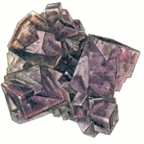

Careers in Chemistry: Dentistry
Calcium Fluoride
x atoms F = 92.135 g CaF₂
1 mol CaF₂
6.02 x 10²³ molecules CaF₂
2 atoms F
=
1.42 x 10²⁴ atoms F
78 g CaF₂
1 mol CaF₂
1 molecules CaF₂
x gallons H₂O = 1.42 x 10²⁴ F atoms
999,999 H₂O molecules
1 mol H₂O
18 g H₂O
1 mL H₂O
1 L H₂O
1 gallon H₂O
=
1 F atom
6.02 x 10²³ H₂O molecules
1 mol H₂O
1 g H₂O
1000 mL H₂O
3.78 L H₂O
Need 11,238 gallons of water needed to dissolve 91.235 g CaF₂ to yield a 1 ppm F¹⁻ solution.

Slide 60
Percent Yield
measured in lab
actual yield
=
x 100
% yield
theoretical yield
calculated on paper
Notes:
Courtesy Christy Johannesson www.nisd.net/communicationsarts/pages/chem
Limiting reactant determines the maximum amount of product that can be formed from the reactants when reactants are not present in stoichiometric quantities.
Amount of product calculated in this way is the theoretical yield, the amount you would obtain if the reaction occurred perfectly and your method of purifying the product was 100% efficient.
Always obtain less product than is theoretically possible. Actual yield, the measured mass of products obtained from a reaction, is less than the theoretical yield.
Percent yield of a reaction is the ratio of the actual yield to the theoretical yield, multiplied by 100% to give a percentage.

Slide 61
When 45.8 g of K₂CO₃ react with excess HCl, 46.3 g of KCl are formed. Calculate the theoretical and % yields of KCl.
actual yield
46.3 g
K₂CO₃ +
2
HCl
2
KCl
+ H₂O + CO₂
+ H₂CO₃
45.8 g
excess
? g
theoretical yield
Theoretical yield
1 mol K₂CO₃
2 mol KCl
74.5 g KCl
x g KCl = 45.8 g K₂CO₃
= 49.4 g KCl
49.4 g
49.4 g KCl
138 g K₂CO₃
1 mol K₂CO₃
1 mol KCl
Actual Yield
Theoretical Yield
46.3 g KCl
% Yield =
% Yield
=
x 100
% Yield = 93.7% efficient
Notes:
Example courtesy Christy Johannesson www.nisd.net/communicationsarts/pages/chem

Slide 62
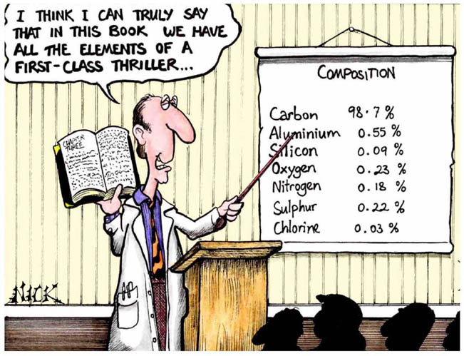
Cartoon courtesy of NearingZero.net

